Slide 1
Amortized analysis

Slide 2
Amortized analysis is a technique used in algorithm analysis to average the cost of operations over a sequence of operations, providing a more realistic estimate of the average time complexity than worst-case analysis.
One of the popular methods used in amortized analysis is the Potential Method. This method involves assigning a potential (or energy) to the data structure and analyzing how this potential changes over time as operations are performed.
The amortized cost of an operation is then determined by considering both the actual cost of the operation and change in potential.

Slide 3


Key Concepts in the Potential Method
Potential Function (Φ):
The potential function Φ is a non-negative function that maps the state of the data structure to a real number. It represents the "stored energy" of the data structure. The choice of potential function is critical and is usually based on the structure and operations of the algorithm being analyzed.
Amortized Cost:
The amortized cost of an operation is the sum of the actual cost of the operation and the change in potential due to the operation. Formally, the amortized cost ​ of the i^{th} operation is defined as:

Slide 4


c_{i}​ is the actual cost of the i^{th} operation.
D_{i}​ is the state of the data structure after the i^{th} operation.
D_{i−1}​ is the state of the data structure before the i^{th} operation.
are the potentials before and after the i^{th} operation, respectively.
Total Amortized Cost:
Over a sequence of n operations, the total amortized cost is given by:

Slide 5
Dynamic Array Amortized Analysis using the Potential Method
Dynamic Array Operations:
Insertion without Resizing:
  If the dynamic array has space available, inserting an element takes constant time O(1).
Insertion with Resizing:
  When the array is full, inserting an element requires resizing the array, typically by doubling its size. This operation involves copying all existing elements to the new array, which takes O(n) time, where n is the number of elements.

Slide 6

Potential Function (Φ):
The potential function is often chosen based on the number of extra spaces available in the array after the i^{th} operation.
A common choice is:
Φ(Di​)=2×(number of elements)−current capacity
This function reflects the "potential energy" stored due to the space utilization. It increases as the array gets closer to being full and decreases when the array is resized.

Slide 7

Initial Conditions:
Start with an empty array of size 1. Initially, there are no elements, so the potential is:
Amortized Cost Calculations:
For each insertion, we calculate the amortized cost, which includes the actual cost of the operation and the change in potential.
Case 1: Inserting without resizing(Array is not full)
  The actual cost = 1(just inserting the element).
  Before insertion: Number of elements = k, Array size = n
  After insertion: Number of elements = k+1, Array size = n

Slide 8
The potential change:

Slide 9
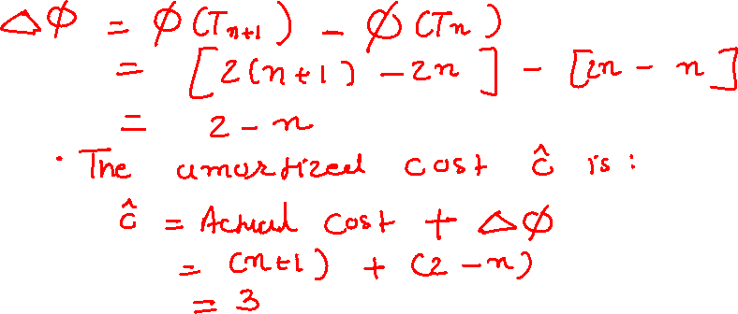
Case 2: Inserting with resizing(Array is full)
The actual cost = n+1 (inserting the element and copying n elements to the new array).
Before insertion: Number of elements =n, Array size = n.
After insertion: Number of elements = n+1, Array size = 2n.
The potential change:

Slide 10
Conclusion
Using the potential method, the amortized cost for each insertion is calculated as 3 for both cases. Since this is constant, we conclude that the amortized cost of insertion in a dynamic array is O(1).
The potential method thus provides a clear understanding of how the cost of resizing is “paid for” by the potential stored in the system from previous operations where the array was not resized.
This ensures that even though individual operations might have high costs, the average cost per operation remains low.

